Slide 1
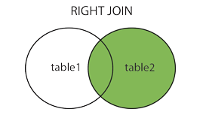
SQL RIGHT JOIN
The RIGHT JOIN keyword returns all records from the right table (table2), and the matched records from the left table (table1). The result is NULL from the left side, when there is no match.
RIGHT JOIN Syntax
SELECT column_name(s) FROM table1 RIGHT JOIN table2 ON table1.column_name = table2.column_name;

Slide 2
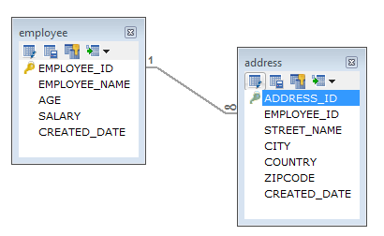
SQL RIGHT JOIN
In a one-to-many relationship, one record in a table can be associated with one or more records in another table.

Slide 3
SQL RIGHT JOIN
Employee
EMPLOYEE_ID | EMPLOYEE_NAME | AGE | SALARY | CREATED_DATE
1 | Peter | 32 | 7000 | 2019-09-03
2 | Dave | 34 | 8000 | 2019-09-04
3 | John | 45 | 10000 | 2019-09-24
Address
ADDRESS_ID | EMPLOYEE_ID | STREET_NAME | CITY | COUNTRY | ZIPCODE | CREATED_DATE
1 | 1 | 18,Dark Street | Chennai | India | 680009 | 2019-09-10
2 | 1 | 90,West Street | Bangalore | India | 655556 | 2019-09-18
3 | 2 | 898,East Street | Bangalore | India | 565565 | 2019-09-14
4 | 2 | 676,North Street | Chennai | India | 767676 | 2019-09-18
5 | 2 | 434,Good Street | Kerala | India | 656565 | 2019-09-16

Slide 4
SQL RIGHT JOIN
RIGHT JOIN Example
SELECT employee.EMPLOYEE_ID,employee.EMPLOYEE_NAME,address.CITY
FROM employee
RIGHT JOIN address ON employee.EMPLOYEE_ID=address.EMPLOYEE_ID;

